Slide 1
Site Reliability
Engineer
Cloud Native Engineer
Combines Expertise in a Wide Range of Adjunct Disciplines
Software Engineer
Security Engineer
DevOps Engineer
Notes:
Software Engineer:
Language agnostic development
Full-stack development
…
Solution Architect:
Provider specific Cloud Services
Deployment Models: Private, Public, Multi, Hybrid clouds
…
Security Engineer
Cloud Security on Application, Infrastructure, UI, and Data level
Compliance risks
Cloud Authentication
…
DevOps Engineer
Containers and orchestration
Release Engineering
…

Slide 2

DORA
(DevOps Research and Assessments) – Key Metrics
Speed
1. Lead Time for Changes
Stability
3. Change Failure Rate
2. Deployment Frequency
4. Time to Restore Service (MTTR)

Slide 3
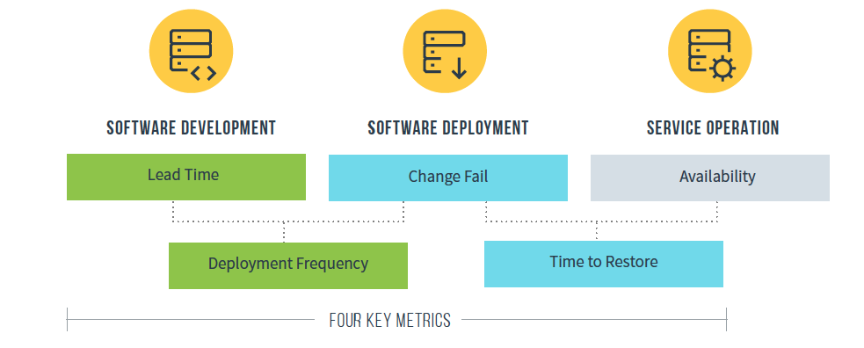
DORA (DevOps Research and Assessments)

Slide 4
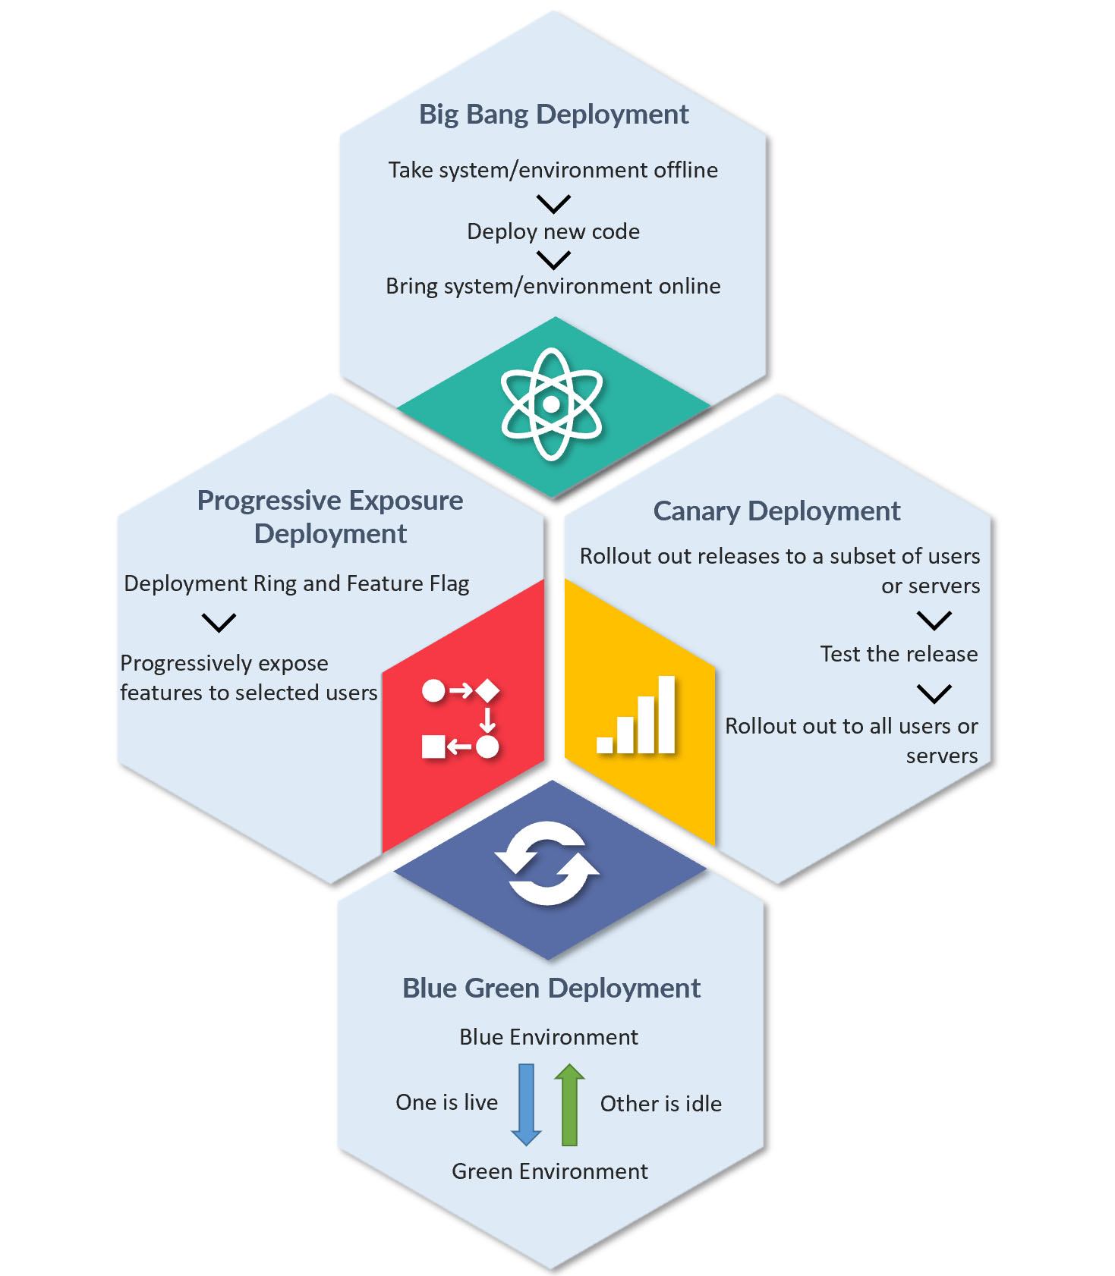
Deployment Patterns

Slide 5
Site Reliability
Engineer
Cloud Native Engineer
Combines Expertise in a Wide Range of Adjunct Disciplines
Software Engineer
Security Engineer
DevOps Engineer
Notes:
Software Engineer:
Language agnostic development
Full-stack development
…
Solution Architect:
Provider specific Cloud Services
Deployment Models: Private, Public, Multi, Hybrid clouds
…
Security Engineer
Cloud Security on Application, Infrastructure, UI, and Data level
Compliance risks
Cloud Authentication
…
DevOps Engineer
Containers and orchestration
Release Engineering
…

Slide 6
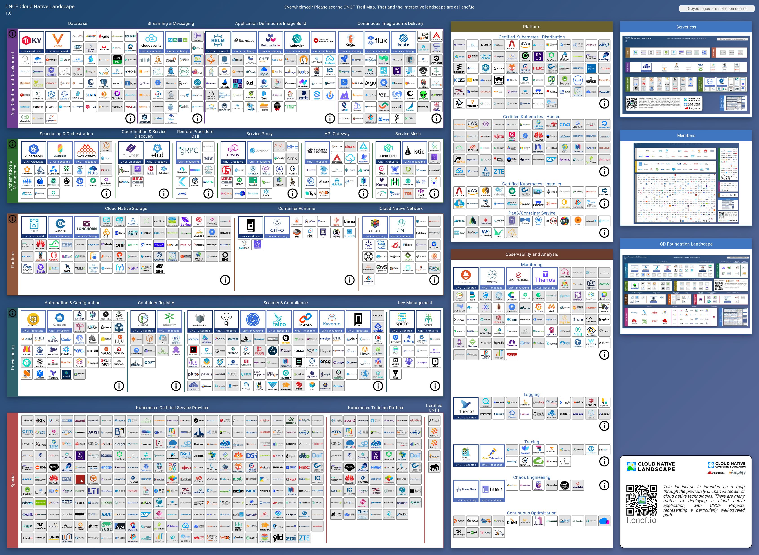




Slide 7
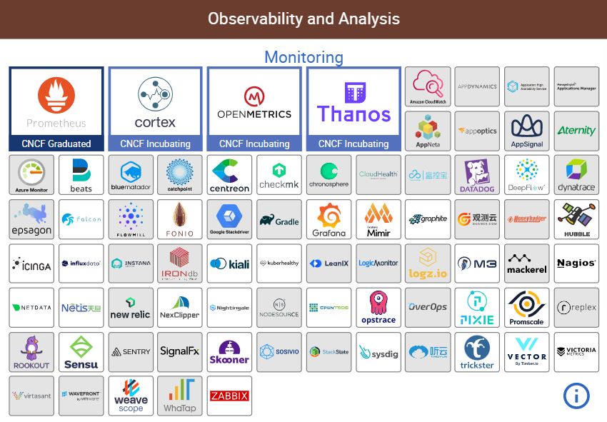

Slide 8
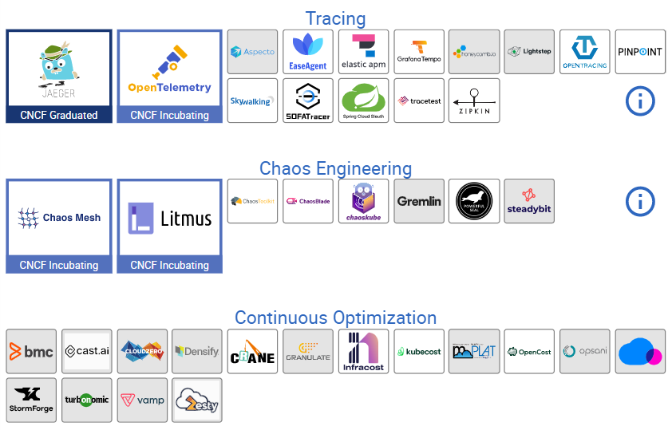



Slide 9
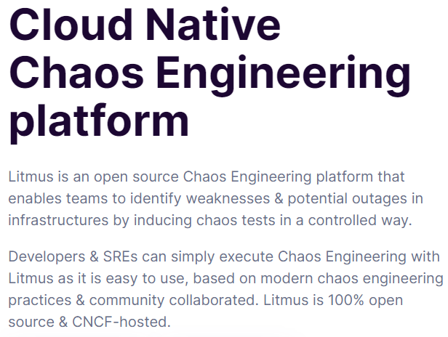
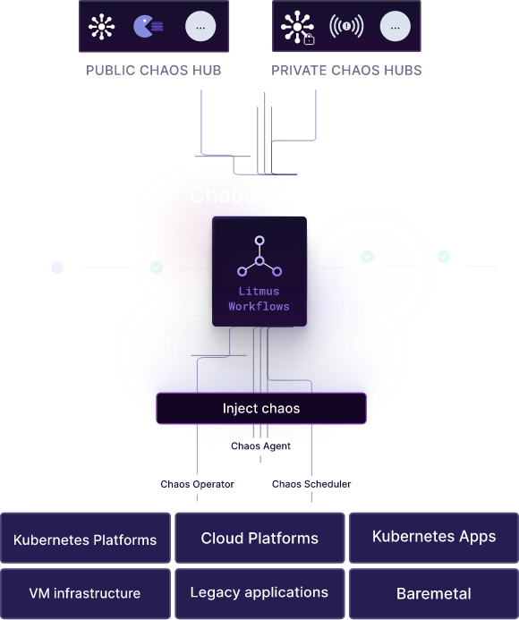

Slide 10
Software Engineer
Cloud Native Engineer
Modern
Notes:
Software Engineer:
Language agnostic development
Full-stack development
…
Solution Architect:
Provider specific Cloud Services
Deployment Models: Private, Public, Multi, Hybrid clouds
…
Security Engineer
Cloud Security on Application, Infrastructure, UI, and Data level
Compliance risks
Cloud Authentication
…
DevOps Engineer
Containers and orchestration
Release Engineering
…

Slide 11
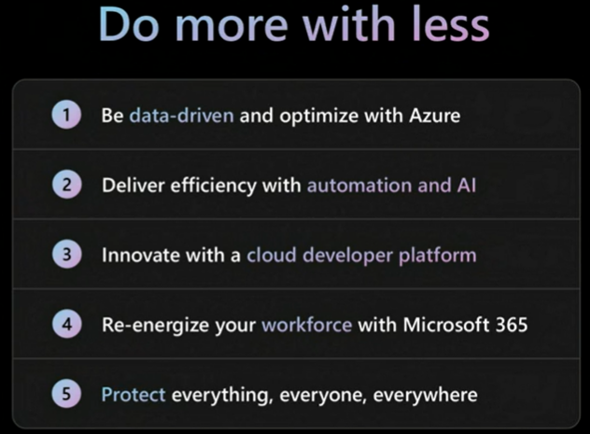
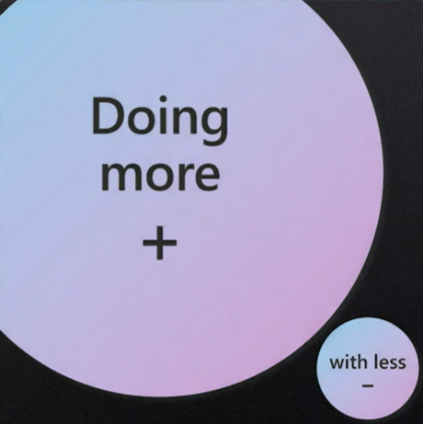
Key Message – Ignite 2022

Slide 12


Slide 13
EPAM Fast Facts – Q2 2022
FOUNDED IN
1993
U.S. HEADQUARTERED
PUBLIC COMPANY
(NYSE:EPAM)
Q2 2022 REVENUES
$1.195B
2021 REVENUES
$3.758B
REVENUE GROWTH
5 Year Revenue
CAGR of 27%
(2016-2021)
61,300+ EPAMers
54,850+ Engineers, Designers & Consultants
50+ Countries & Regions
REVENUE BY INDUSTRY VERTICAL
(Reported $ and % of Total Revenues)
REVENUE BY GEOGRAPHY
(Reported $ and % of Total Revenues)
Travel & Consumer
Financial Services
EMEA
$276M 23.1%
$251M 21.0%
$423M 35.4%
Life Sciences & Healthcare
AMERICAS
Software & Hi-Tech
$722M 60.4%
$129M 10.8%
$195M 16.3%
CEE
Business
Information & Media
$20M 1.7%
Emerging
APAC
$198M 16.6%
$146M 12.2%
$30M 2.5%
Figures are as of Q2 2022, percentages are presented on a YoY basis unless otherwise noted.

Slide 14

Growing, Global Presence in more than 50 Countries & Regions
Austria
Belgium
France
Germany
Ireland
Italy
Malta
Netherlands
Spain
Portugal
Sweden
Switzerland
United Kingdom
Armenia
Georgia
Israel
Lebanon
Turkey
UAE
Canada
Kazakhstan
Kyrgyzstan
Uzbekistan
United States
China
Hong Kong SAR
Belarus
Bulgaria
Croatia
Czech Republic
Hungary
Latvia
Lithuania
Montenegro
Poland
Romania
Serbia
Slovakia
Ukraine
Japan
Mexico
Argentina
Brazil
Colombia
Dominican Republic
India
Malaysia
Singapore
Vietnam
Australia
South Africa
Countries and regions listed are as of July 2022. Russia removed per April 7, 2022 SEC filing.

Slide 15



EPAM India
Key facts
Locations
6,000+ FTE
150+
900+
50+
100%+ growth in 2021
Active customers
Active Projects
Net Promoter
Score
550+ FTE
Location Highlights
Capabilities:
Digital
Data
Cloud
Quality Engineering
Services:
Product Development & Modernization
Cloud Transformation and Migration
Data and Intelligence
Quality Engineering
Technology Transformation
Differentiators:
Startup culture
Engineering Excellence
Agile
Smart Hiring
1,200+ FTE
2,950+ FTE
950+ FTE
350+ FTE
INDUSTRIES
SOFTWARE & HI-TECH​
ENERGY​
FINANCIAL SERVICES & INSURANCE​
HEALTHCARE & LIFE SCIENCES
MEDIA & BUSINESS INFO​
RETAIL & DISTRIBUTION​
Notes:
Animated slide – Click on a city to see a slide with more detail about the location

Slide 16

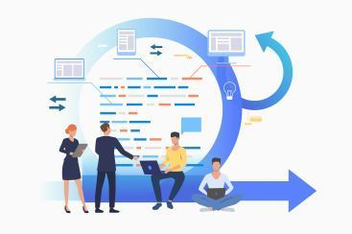




EPAM India Difference
Our Start-up like culture makes the difference
ENGINEERING EXCELLENCE CULTURE
AGILE MANAGEMENT CULTURE
PEOPLE PROCESSES
EngX360 Continuous Improvement
Baseline, assessments, certifications, improvement, recertifications
Truly Agile
All functions are managed on Scrum
Quarterly release planning aligned with yearly KPI’s and executed with aligned 2-week sprints
Agile Thinking workshops
Global
Alignment with global Delivery & Practices
Results Relentlessly
Xtreme and EngX squad involvement
Leveraging best practices for architecture and technology
Hiring
Coding tests and coding challenges
Certified interviewers
High Trust, High Performance
Raise the Bar – Goal Setting, Continuous Feedback and Aspirations Management
Learning
Capability Building Program – SA, DM, Lead Development Programs
Promotions through unified assessments
EngX Culture
Hackathons, coding and architecture katas, dojos, gamification, I Can Code, quizzes, and more
EngX Education
Bootcamps, Clean Code, Clean Design, EngOps Model (EoM), Design Thinking, and more
Dedicated Engineering Labs
RD/Fresh Graduate & Incubation Labs
EngX Badges

Slide 17






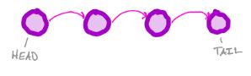


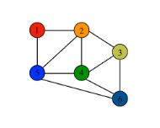





Engineering Incubation Labs
FULLSTACK ENGINEERING LABS
CLOUD ENGINEERING LABS
DATA-STRUCTURES & ALGORITHMS LAB
SRE LAB
Mentor led learning
Self-assessment exercises
Focusses on Angular/React/* as frontend
MS: .NET MVC/WebAPI + Azure as backend skillsets
Java: Spring MVC, Springboot, AWS
JS: MEAN, MERN & MEVN stacks, T- shaped developer skills
Flutter and ReactNative labs
Focus on Cloud native application development using AWS/Azure Platform and Infrastructure services
Assignment based self-paced learning
Detailed course with experienced associates as trainers and mentors
Measure, Compare, Research & Chose
Trainer/mentor led classes + Self learning exercises
Runtime analysis, Big O
Recursion, Arrays, Stack, Queues, List & Heaps
Trees, Graphs & Tries
Algorithms – KMP, Robin Karp, etc.
Dynamic Programming
Understanding SLA, SLO and SLI
Managing Production Changes
Incidents and Postmortems
Observability: Synthetic and End User Monitoring
Observability: Infra and Application Monitoring
Security Essentials and Security Assessment Tools

Slide 19


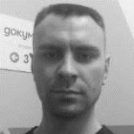






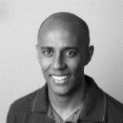


Most Valuable Professionals
Recognition for contributing with their knowledge to the Microsoft communities
Catalin Gheorghiu
Azure, Azure IoT, Windows Development
Igor Sychev
Azure, Azure Policy & Governance
Jared Rhodes
Azure, Azure IoT, Xamarin
Karl Ots
Microsoft Regional Director, Azure, Cloud Infrastructure Protection
Michelle Gutzait
Data Platform, Azure Synapse Analytics
Mihail Mateev
Microsoft Regional Director, Azure, Data Platform
Mikhail Khviadchenia
Azure, Azure Arc
Sergey Tihon
Development Technologies, .NET
Thiago Custodio
Azure, Azure Functions
Venkata Polisetty
Business Apps, Dynamics 365, Power Platform
Wesley Camargo
Development Technologies, Azure DevOps
19

Slide 20
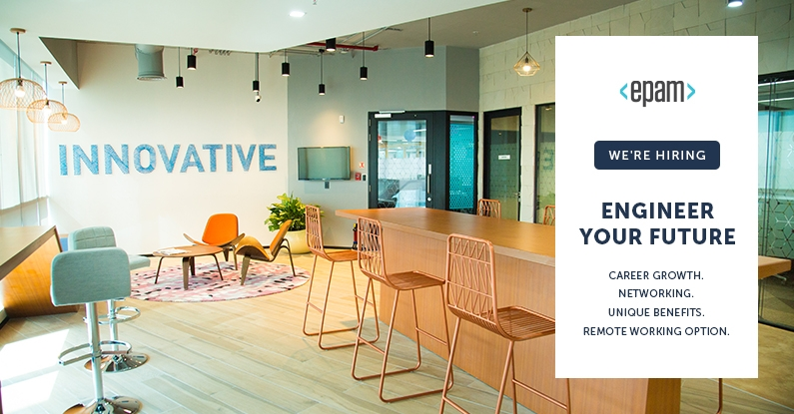

Slide 21
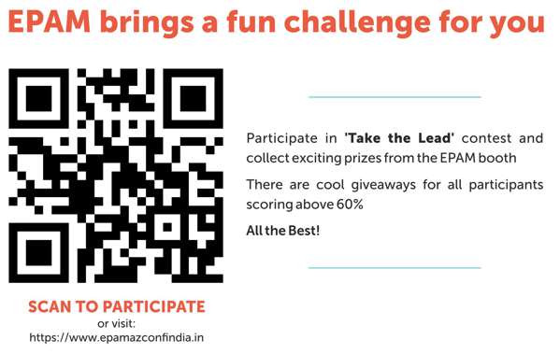
epam.com
epam.com/services/engineer/cloud

Slide 22




Big Thank you …
Participants
Speakers
Organizers
Sponsors

Slide 23
Thank you!

Slide 24
